Slide 1
Marketing Analytics
Project 3 – Mobile App Behavior
Group S1- 3
Benneth Johnson
Nikhil joshi
Rahul Karippurathukattil Suresh
Gurpreet Kaur
Pranav Ratnakar Jadhav

Slide 2
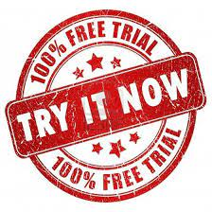


Overview of Problem
User has signed up for free version of the product.
Predict and make Strategy for unhappy customers
Convince them to upgrade themselves for paid membership

Slide 3
Review of Data Source
Data gives overview about enrolled customers.
Total Number of observations – 50000
Total number of features- 12
8 numerical
4 categorical
Missing values in- Enrolled date
Target feature- Enrolled

Slide 4
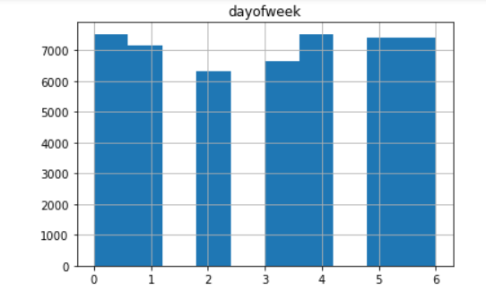
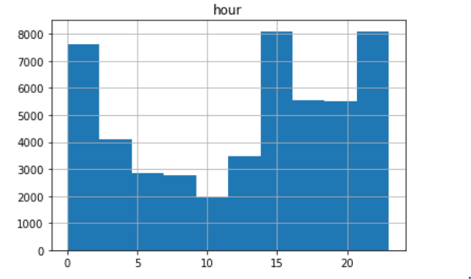
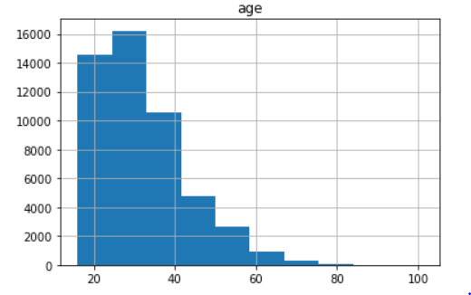
Descriptive Insights
We see that the most of the subscriptions are on Sunday, Wednesday and Friday
Maximum subscriptions occurred at 3pm and 8pm and the lowest subscriptions occur at 10am
Highest customers are from age group 20 to 30

Slide 5
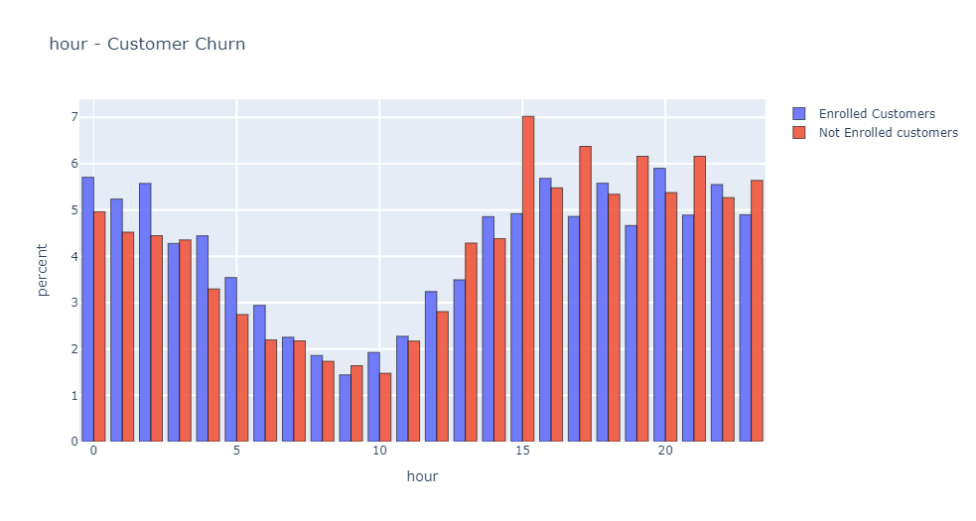
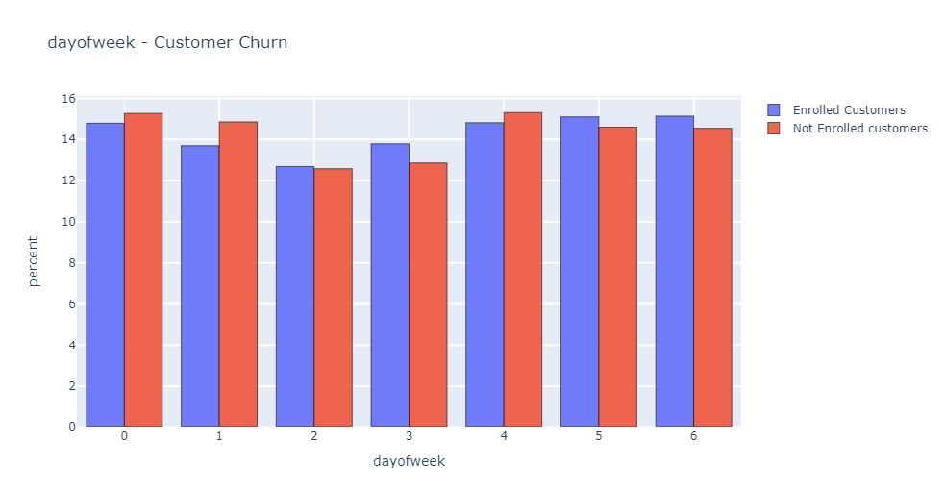
Descriptive Insights

Slide 6
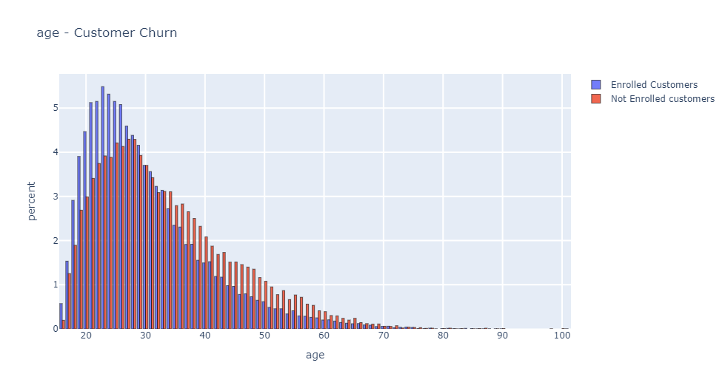
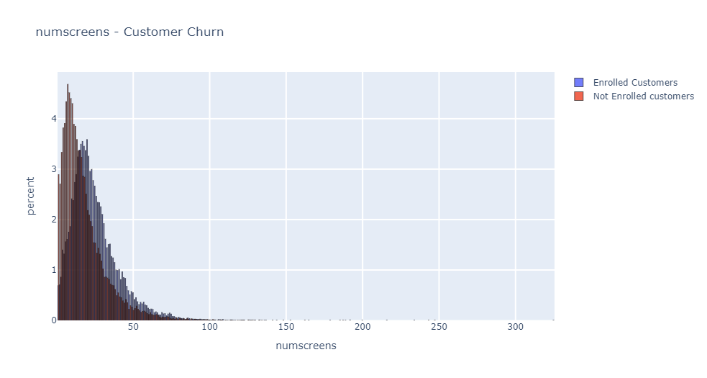

Slide 7
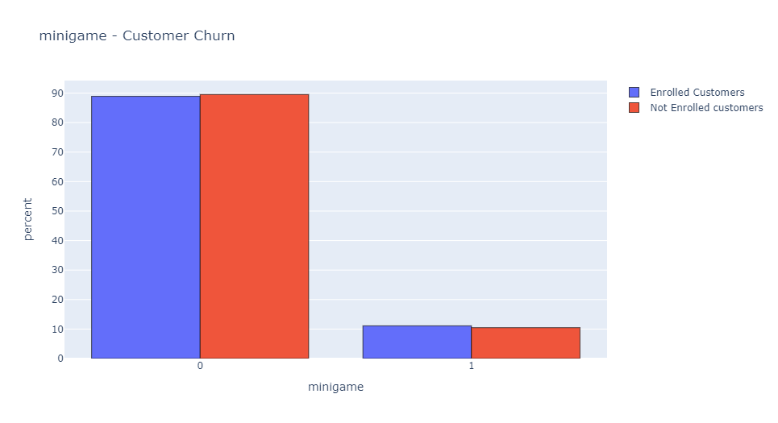
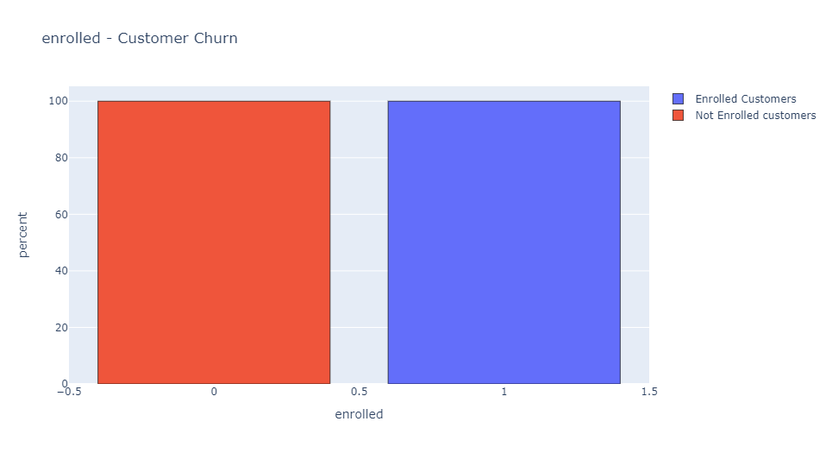
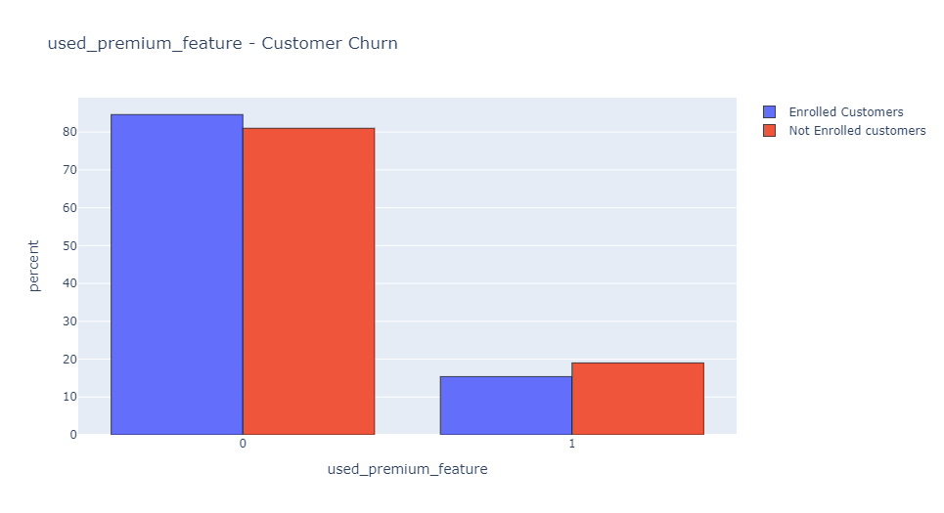
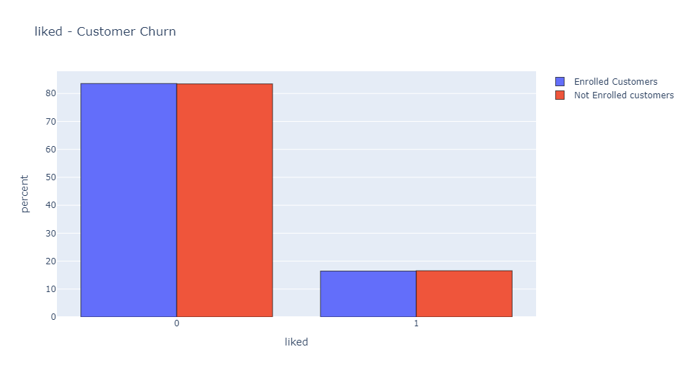

Slide 8
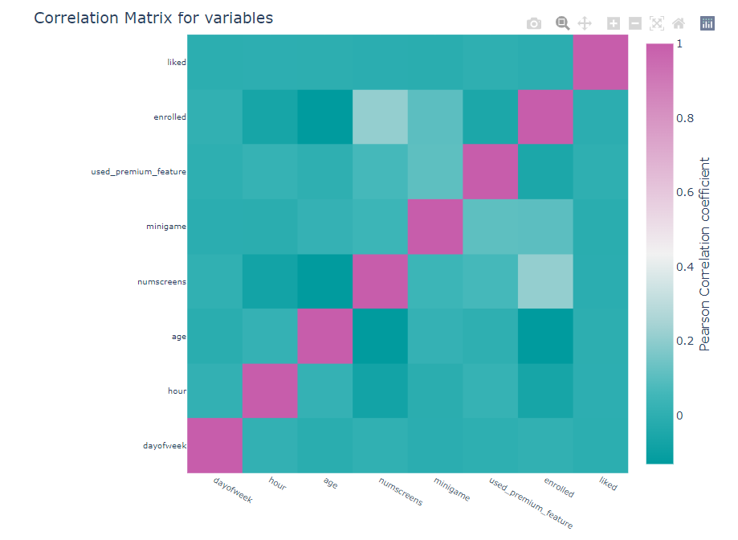
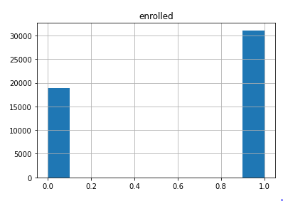
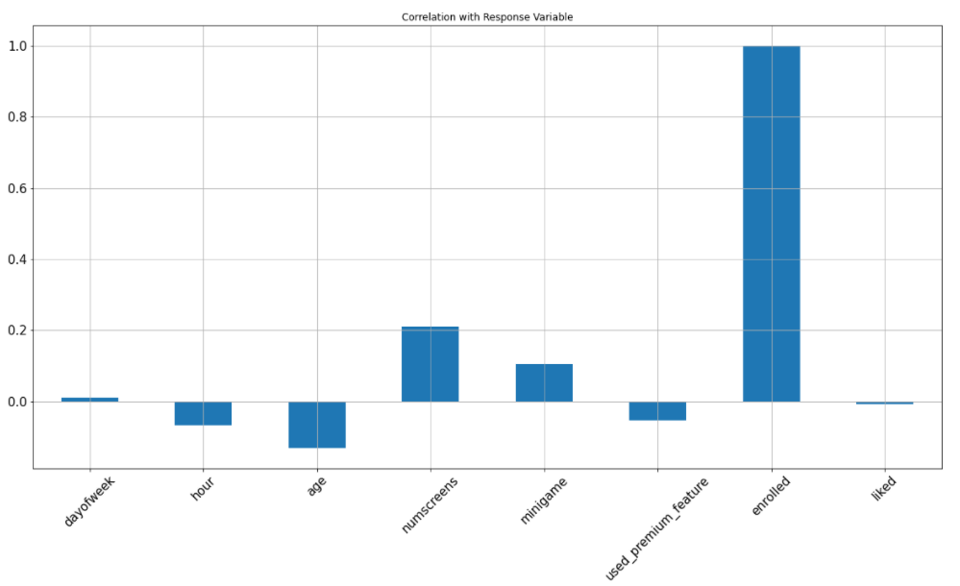

Descriptive Insights (Contd….)
We can clearly see that the customers enrolled are much more than the customers not enrolled and hence a good strategy has the potential to convert them too.
Here we see that the correlation with the enrolled, numscreens, mingames and dayofweek are positive whereas whereas the correlation with the rest of the features negative .

Slide 9
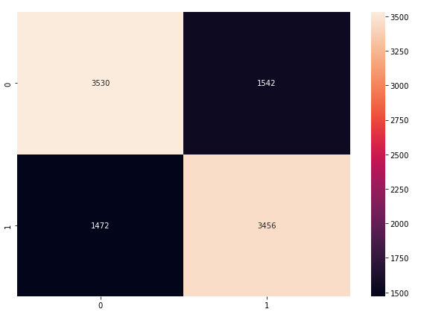
Interpretation AND Results
Confusion Matrix between Y_test and Y_Predicted.
Our model predicts 70% of the total observations correctly.
69.86% of the enrolled clients predicted by the model were enrolled instances in real but it wrongly predicted 69.14% of them.
The classifier model predicted 70% of the enrolled clients as enrolled. And 60.63% of enrolled customers were’nt recognized.

Slide 10
Future Recommendations
Maximum people have liked the app but not subscribed, so it is imperative to take feedback from the user and know the reasons for non-subscriptions.
Target age group after 30 years of age and let them know about the features which could interest them.
No data regarding discounts/offers/freebies. Customers tend to buy the product/service having discounts. So, include these type of offers.

